Slide 1
Physical Characteristics of the Ocean

Slide 2
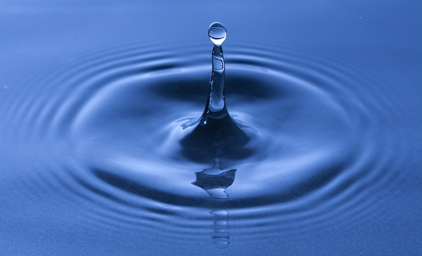
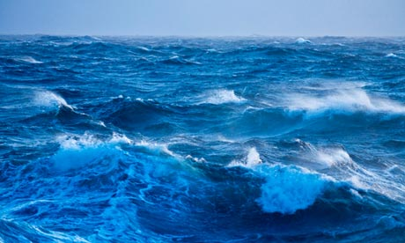
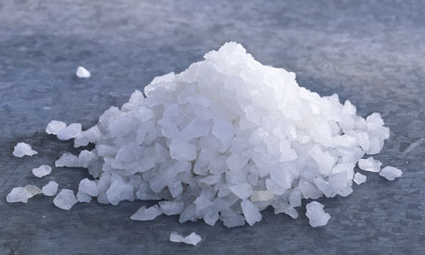
What is ocean water?
A mixture of gases (air) and salt (NaCl) from rocks.

Slide 3
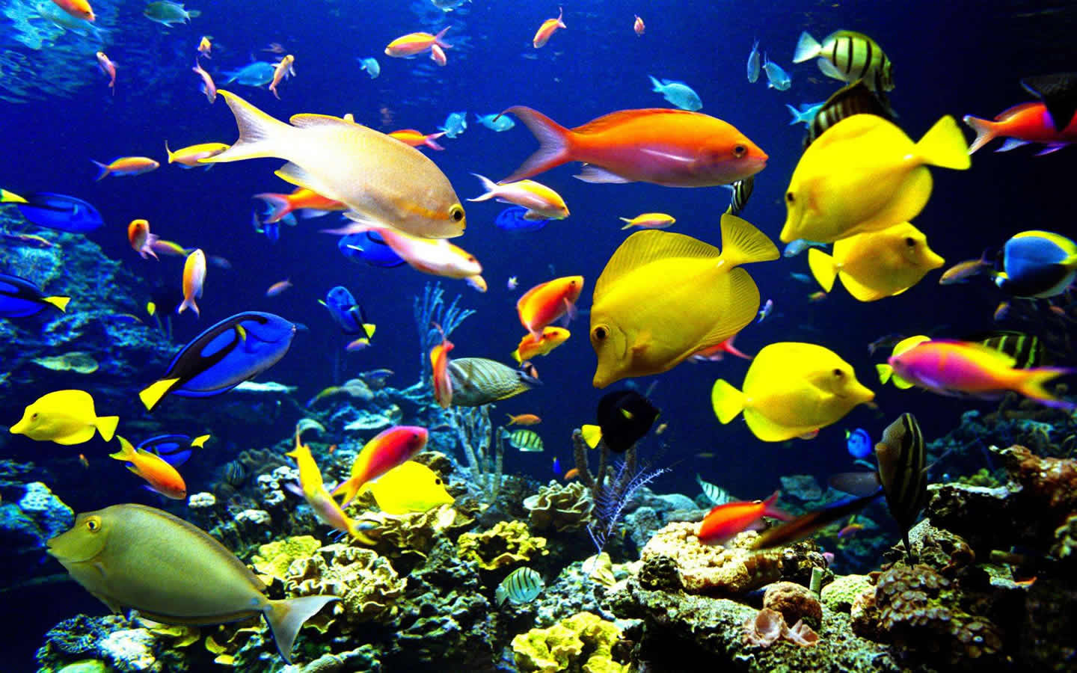
Ocean Water
Marine organisms are dependent upon the air in the water to survive.

Slide 4
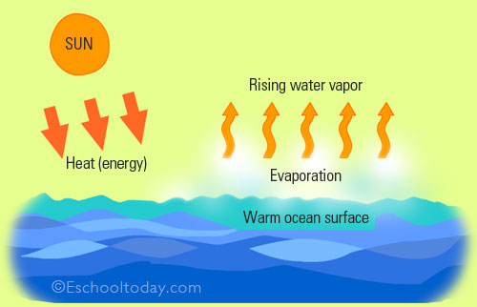
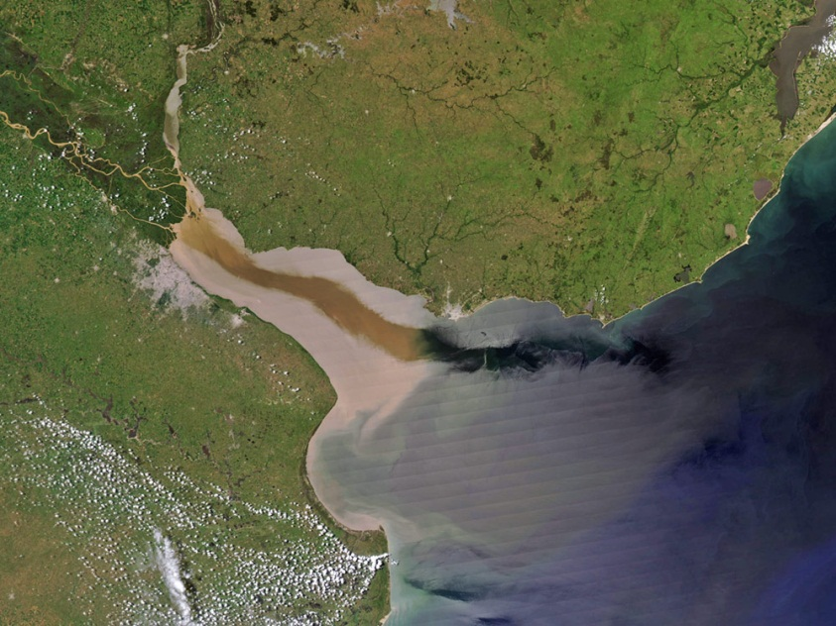
Ocean Water
The amount of salinity in the ocean varies upon:
Rates of evaporation and
precipitation
Amounts of erosion and runoff

Slide 5
Let’s Review
What is ocean water made of?
How can marine organisms survive in the ocean?
If water evaporates in the ocean, what happens to the salinity?
If large river empties into the ocean, what happens to the salinity?

